Slide 1

Project Time Management

Slide 2
Importance of Project Schedules
Managers often cite delivering projects on time as one of their biggest challenges
Time has the least amount of flexibility; it passes no matter what happens on a project
Schedule issues are the main reason for conflicts on projects, especially during the second half of projects

Slide 3
Project Time Management Processes
Planning schedule management: determining the policies, procedures, and documentation that will be used for planning, executing, and controlling the project schedule
Defining activities: identifying the specific activities that the project team members and stakeholders must perform to produce the project deliverables
Sequencing activities: identifying and documenting the relationships between project activities
Estimating activity resources: estimating how many resources a project team should use to perform project activities
Estimating activity durations: estimating the number of work periods that are needed to complete individual activities
Developing the schedule: analyzing activity sequences, activity resource estimates, and activity duration estimates to create the project schedule
Controlling the schedule: controlling and managing changes to the project schedule

Slide 4
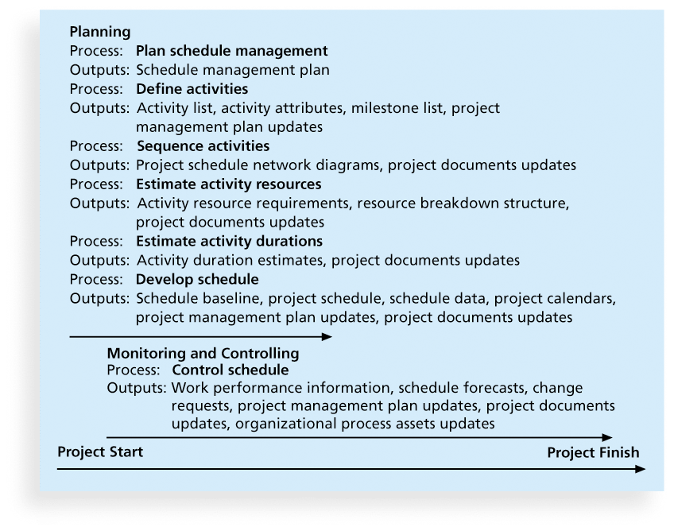
Project Time Management Summary

Slide 5
Planning Schedule Management
The project team uses expert judgment, analytical techniques, and meetings to develop the schedule management plan
A schedule management plan includes:
The scheduling methodology
Level of accuracy and units of measure
Rules of performance measurement
Reporting formats
Process descriptions

Slide 6
Defining Activities
An activity or task is an element of work normally found on the work breakdown structure (WBS) that has an expected duration, a cost, and resource requirements
Activity definition involves developing a more detailed WBS and supporting explanations to understand all the work to be done so you can develop realistic cost and duration estimates

Slide 7
Activity Lists and Attributes
An activity list is a tabulation of activities to be included on a project schedule that includes
the activity name
an activity identifier or number
a brief description of the activity
Activity attributes provide more information such as predecessors, successors, logical relationships, leads and lags, resource requirements, constraints, imposed dates, and assumptions related to the activity

Slide 8
Sequencing Activities
Involves reviewing activities and determining dependencies
A dependency or relationship is the sequencing of project activities or tasks
You must determine dependencies to use the critical path analysis

Slide 9
Three types of Dependencies
Mandatory dependencies: The relationships between project activities that are inherent or unavoidable. Also called hard logic or hard dependencies.
Discretionary dependencies: Defined by the project team, sometimes referred to as soft logic. The project manager or team decides to use it for better workflow, efficiency, or experience — but they can be changed if needed
External dependencies: involve relationships between project and non-project activities. E.g. receive government approval for any project

Slide 10
Network Diagrams
Network diagrams are the preferred technique for showing activity sequencing
A network diagram is a schematic display of the logical relationships among, or sequencing of, project activities
Two main formats are:
The arrow diagramming method, and
Precedence diagramming methods

Slide 11
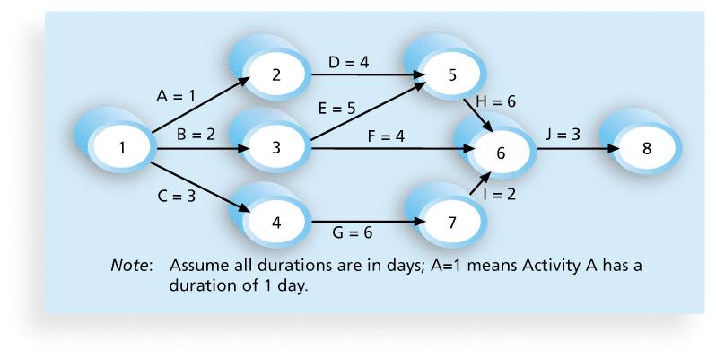
Network Diagram for Project X

Slide 12
Arrow Diagramming Method (ADM)
Also called activity-on-arrow (AOA) network diagrams
Activities are represented by arrows
Nodes or circles are the starting and ending points of activities
Can only show finish-to-start dependencies

Slide 13
Process for Creating AOA Diagrams
Find all of the activities that start at node 1. Draw their finish nodes and draw arrows between node 1 and those finish nodes. Put the activity letter or name and duration estimate on the associated arrow
Continuing to draw the network diagram, working from left to right. Look for bursts and merges. Bursts occur when a single node is followed by two or more activities. A merge occurs when two or more nodes precede a single node
Continue drawing the project network diagram until all activities are included on the diagram that have dependencies
As a rule of thumb, all arrowheads should face toward the right, and no arrows should cross on an AOA network diagram

Slide 14
Precedence Diagramming Method (PDM)
Activities are represented by boxes
Arrows show relationships between activities
More popular than ADM method and used by project management software
Better at showing different types of dependencies

Slide 15
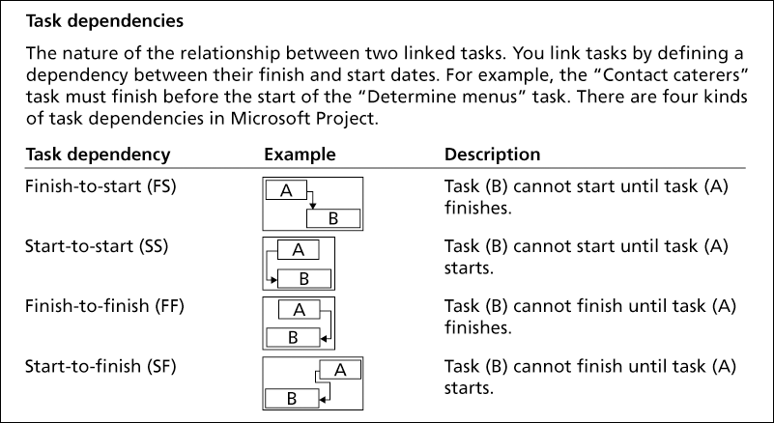
Task Dependency Types
Task dependency | Example | Description
Finish-to-start (FS) | A diagram of a box labeled A in the top left corner and a box labeled B in the bottom right corner. An arrow points from the right side of box A to the top side of box B. | Task (B) cannot start until task (A) finishes.
Start-to-start (SS) | A diagram of a box labeled A above a box labeled B. Box B is more aligned to the right. An arrow points from the left side of box A down towards the left side of box B. | Task (B) cannot start until task (A) starts.
Finish-to-finish (FF) | A diagram of a box labeled A above a box labeled B. Box B is more aligned to the left. An arrow points from the right side of box A and down to the right side of box B. | Task (B) cannot finish until task (A) finishes.
Start-to-finish (SF) | A diagram of a box labeled A in the top right corner and a box labeled B in the bottom left corner. An arrow points from the left side of box A to the right side of box B. | Task (B) cannot finish until task (A) starts.

Slide 16
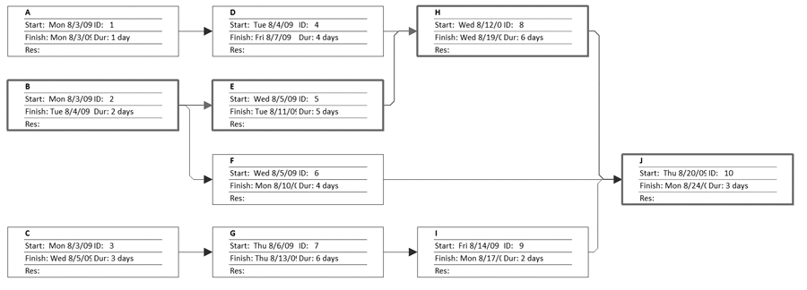
Sample PDM Network Diagram

Slide 17
Estimating Activity Resources
Resources are people, equipment, and materials
Before estimating activity durations, you must have a good idea of the quantity and type of resources that will be assigned to each activity.
Consider important issues in estimating resources
How difficult will it be to do specific activities on this project?
What is the organization’s history in doing similar activities?
Are the required resources available?

Slide 18
Activity Duration Estimating
Duration is the total time that an activity takes to complete — from start to finish — including working time and waiting time (like weekends or breaks).
A task starts on Monday and finishes on Friday → Duration = 5 days
Effort is the total amount of work or labor time (in work hours or workdays) that people actually spend working on an activity.
If two people each work 4 hours per day for 5 days → Effort = 2 × 4 × 5 = 40 person-hours

Slide 19
Three-Point Estimates
Instead of providing activity estimates as a discrete number, such as four weeks, it’s often helpful to create a three-point estimate
an estimate that includes an optimistic, most likely, and pessimistic estimate, such as three weeks for the optimistic, four weeks for the most likely, and five weeks for the pessimistic estimate
Three-point estimates are needed for PERT and Monte Carlo simulations

Slide 20
Developing the Schedule
The ultimate goal is to create a realistic project schedule that provides a basis for monitoring project progress for the time dimension of the project
Important tools and techniques include Gantt charts, critical path analysis, and critical chain scheduling, and PERT analysis

Slide 21
Gantt Charts
Gantt charts provide a standard format for displaying project schedule information by listing project activities and their corresponding start and finish dates in a calendar format
Symbols include:
A black diamond: a milestones
Thick black bars: summary tasks
Lighter horizontal bars: durations of tasks
Arrows: dependencies between tasks

Slide 22
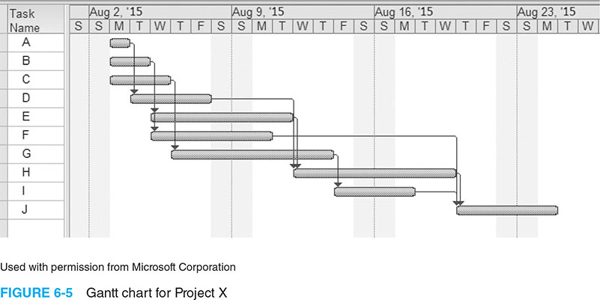
Gantt Chart for Project X

Slide 23
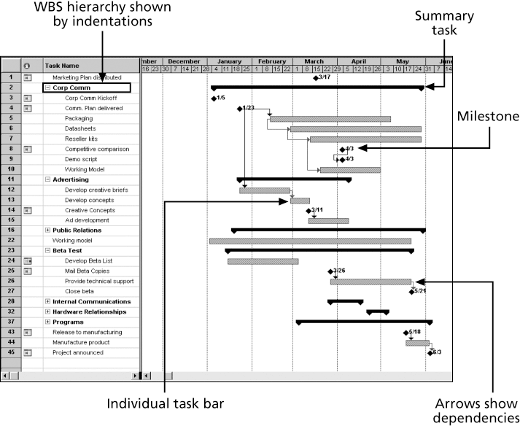
Gantt Chart for Software Launch Project

Slide 24
Adding Milestones to Gantt Charts
Many people like to focus on meeting milestones, especially for large projects
Milestones emphasize important events or accomplishments on projects
Normally create milestone by entering tasks with a zero duration, or you can mark any task as a milestone

Slide 25
SMART Criteria
Milestones should be
Specific
Measurable
Assignable
Realistic
Time-framed

Slide 26
Critical Path Method (CPM)
The Critical Path Method is the sequence of scheduled activities that determines the project's duration.
A critical path for a project is the series of activities that determines the earliest time by which the project can be completed
The critical path is the longest path through the network diagram and has the least amount of slack or float
Slack or float is the amount of time an activity may be delayed without delaying a succeeding activity or the project’s finish date

Slide 27
Calculating the Critical Path
First, develop a good network diagram
Add the duration estimates for all activities on each path through the network diagram
The longest path is the critical path
If one or more of the activities on the critical path takes longer than planned, the whole project schedule will slip unless the project manager takes corrective action

Slide 28
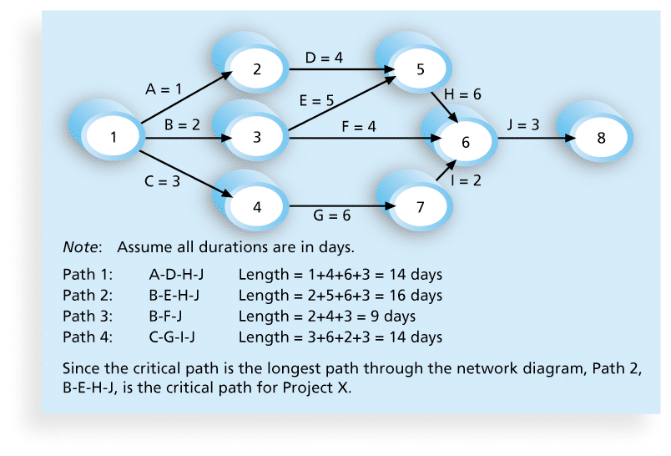
Determining the Critical Path for Project X

Slide 29
Using Critical Path Analysis to Make Schedule Trade-offs
Free slack or free float is the amount of time an activity can be delayed without delaying the early start of any immediately following activities
Total slack or total float is the amount of time an activity may be delayed from its early start without delaying the planned project finish date
A forward pass through the network diagram determines the early start and finish dates
A backward pass determines the late start and finish dates

Slide 30
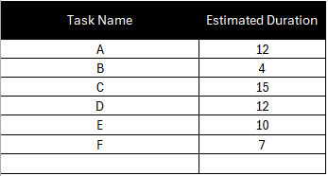
Example of Calculating the Critical Path
List Project Tasks and Estimate their Duration

Slide 31
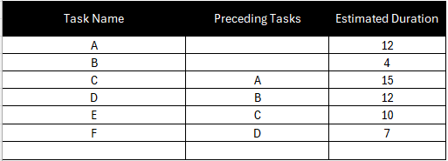
Example of Calculating the Critical Path
Identify Task Dependencies

Slide 32
Example of Calculating the Critical Path
Create a Critical Path Diagram
Every project task has a start and finish time.
Earliest start time (ES)
Earliest finish time (EF)
Latest start time (LS)
Latest finish time (LF)
Slack or float

Slide 33
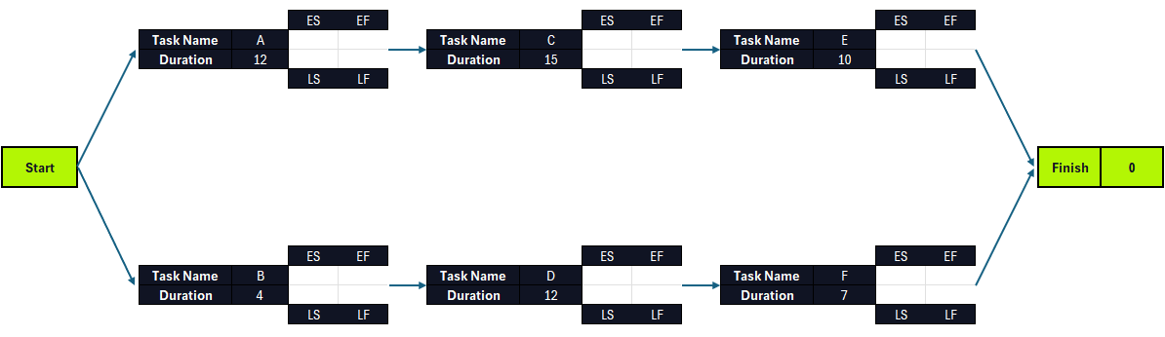
Example of Calculating the Critical Path

Slide 34
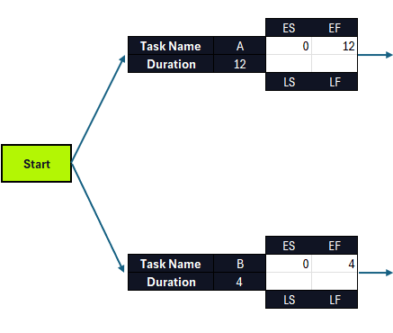
Example of Calculating the Critical Path
Use the Critical Path Algorithm Formulas
Calculate the ES and EF and slack using the critical path Forward Pass formula.

Slide 35
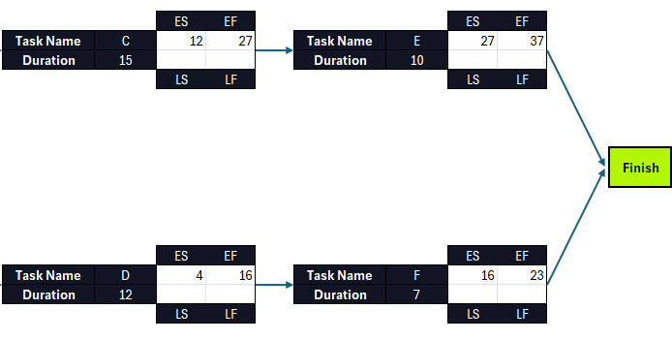
Example of Calculating the Critical Path

Slide 36
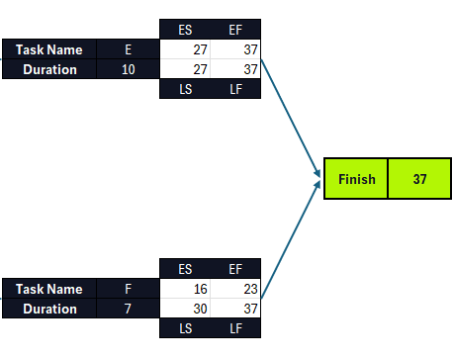
Example of Calculating the Critical Path
Calculate the LS and LF and slack using the critical path Backward Pass formula.

Slide 37
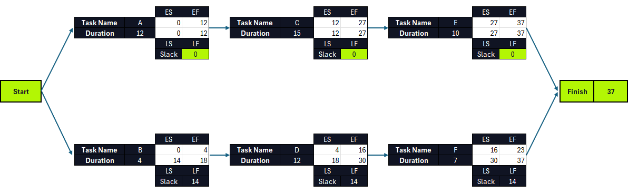
Example of Calculating the Critical Path

Slide 38
Importance of Updating Critical Path Data
It is important to update the project schedule information to meet time goals for a project
The critical path may change as you enter actual start and finish dates
If you know the project completion date will slip, negotiate with the project sponsor

Slide 39
Critical Chain Scheduling
Critical chain scheduling
a method of scheduling that considers limited resources when creating a project schedule and includes buffers to protect the project completion date
Uses the Theory of Constraints (TOC)
a management philosophy developed by Eliyahu M. Goldratt and introduced in his book The Goal.
Attempts to minimize multitasking
when a resource works on more than one task at a time

Slide 40
Buffers and Critical Chain
A buffer is additional time to complete a task
Murphy’s Law states that if something can go wrong, it will
Parkinson’s Law states that work expands to fill the time allowed
In traditional estimates, people often add a buffer to each task and use it if it’s needed or not
Critical chain scheduling removes buffers from individual tasks and instead creates
a project buffer or additional time added before the project’s due date
feeding buffers or additional time added before tasks on the critical path

Slide 41
Program Evaluation and Review Technique (PERT)
PERT is a network analysis technique used to estimate project duration when there is a high degree of uncertainty about the individual activity duration estimates
PERT uses probabilistic time estimates
duration estimates based on using optimistic, most likely, and pessimistic estimates of activity durations, or a three-point estimate

Slide 42
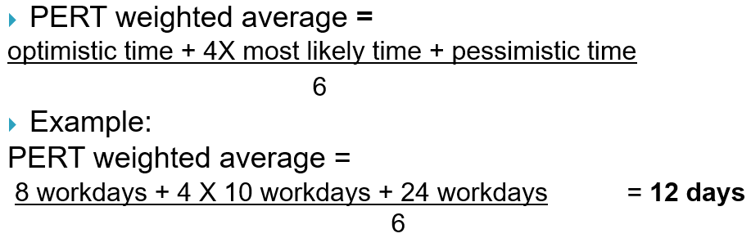
PERT Formula and Example
where optimistic time= 8 days
most likely time = 10 days, and
pessimistic time = 24 days
Therefore, you’d use 12 days on the network diagram instead of 10 when using PERT for the above example

Slide 43
Agile and Time Management
The core values of the Manifesto for Agile Software Development are
Customer collaboration over contract negotiation
Responding to change by following a plan
The product owner defines and prioritizes the work to be done within a sprint, so collaboration and time management are designed into the process
Teams focus on producing a useful product in a specified timeframe with strong customer input
Don’t emphasize defining all the work before scheduling it

Slide 44
Schedule Control Suggestions
Perform reality checks on schedules
Allow for contingencies
Don’t plan for everyone to work at 100% capacity all the time
Hold progress meetings with stakeholders and be clear and honest in communicating schedule issues

Slide 45
Controlling the Schedule
Goals are to know the status of the schedule, influence factors that cause schedule changes, determine that the schedule has changed, and manage changes when they occur
Tools and techniques include
Progress reports
A schedule change control system
Project management software, including schedule comparison charts like the tracking Gantt chart
Variance analysis, such as analyzing float or slack
Performance management, such as earned value (chapter 7)

Slide 46
Reality Checks on Scheduling
First review the draft schedule or estimated completion date in the project charter
Prepare a more detailed schedule with the project team
Make sure the schedule is realistic and followed
Alert top management well in advance if there are schedule problems

Slide 47
Working with People Issues
Strong leadership helps projects succeed more than good PERT charts
Project managers should use
empowerment
incentives
discipline
negotiation

Slide 48
Chapter Summary
Project time management is often cited as the main source of conflict on projects, and most IT projects exceed time estimates
Main processes include
Plan schedule management
Define activities
Sequence activities
Estimate activity resources
Estimate activity durations
Develop schedule
Control schedule

